Slide 1

USA-GHANA Investment
GOVERNMENT BUSINESS -NATIONAL STRATEGY, PROGRAMMES & Investment opportunities in GHANA’S Agriculture.
PRESENTED BY: Hon Eric Opoku
(Minister for food and agriculture)
MOFA

Slide 2
OUTLINE OF PRESENTAION
Country Context
Agriculture, Ghana’s Major Economic Sector
Investment Opportunities
Ghana, your best destination for investment
Investment Incentives
Conclusion

Slide 3

Agriculture, Ghana’s Major Economic Sector
  Agriculture: 21% share of GDP
  38.3% of the population employed
Large tracts of arable land, various ecological zones with excellent soil, suitable for the production of multiple crops and livestock.
  Total land area of 23.9 million ha.
  13.6 million hectares suitable for agriculture
  6.6 million ha uncultivated
  1.9 million ha has potential for irrigation.

Slide 4
Agriculture, Ghana’s Major Economic Sector (Cont’d)
Two rainy seasons in the South, average rainfall of 1,207mm and one season in the northern sector.
Well-endowed water resources - total length of 6,917 km
Warm tropical climate
Best soil for production of Stevia (non-diabetic sugar)

Slide 5
Ghana, your best destination for investment

Slide 6

Natural Resource Endowment
The largest gold-producing country in Africa
2nd largest cocoa producer in the world
3rd largest bauxite reserve in Africa
Oil & Gas reserves
The largest producer of tuna in Africa & 4th globally
2nd largest producer of yam in the world

Slide 7

Why Invest in Ghana
Ghana is the best destination to invest in West Africa and 6th on the continent, according to the Rand Merchant Bank (RMB) 'Where to Invest in Africa 2024' report.

Slide 8
Why Invest in Ghana (Cont’d)
Excellent agro-ecological conditions;
Various investment opportunities; and
Government’s commitment to support private sector development.

Slide 9
Why Invest in Ghana (Cont’d)
PROMISING INVESTMENT OPPORTUNITIES
  Cocoa products: Ghana is the 2nd largest producer of cocoa in the world, and also produces the best premium quality of cocoa in the World market.
  Shea butter: Finest quality - Best quality of shea butter globally
  Cashew: Needs Value Addition of the Cashew Apple (E.g. Brandy, Wine and others)
  Foodstuffs: Rice (1.5m/600,000tonnes production, deficit estimated at 900,000 tonnes), poultry, soya, cassava (26 million tonnes production annually, 3rd in West Africa and 4th globally), etc.
  Other Tree Crops: Oil Palm, Mango, Coconut, Rubber and Citrus to be processed.

Slide 10

Ghana is committed to attracting private investment for growth
Ambitious Programmes to Drive Growth Through Private Sector Investment
    Feed Ghana Programme (FGP)
      Feed the Industry
      Farmers’ Service Centres
      Irrigation for Wealth Creation
    24-Hour Economy Programme
    Ambitious infrastructure investment under the $10 Billion Big Push

Slide 11

Ghana is committed to attracting private investment for growth (Cont’d).
Ghana has a great Global reputation and currently hosts the following:
  Secretariat of AfCFTA;
  Head Office of Alliance for a Green Revolution in Africa (AGRA); and
  Regional Office of FAO for Africa.

Slide 12
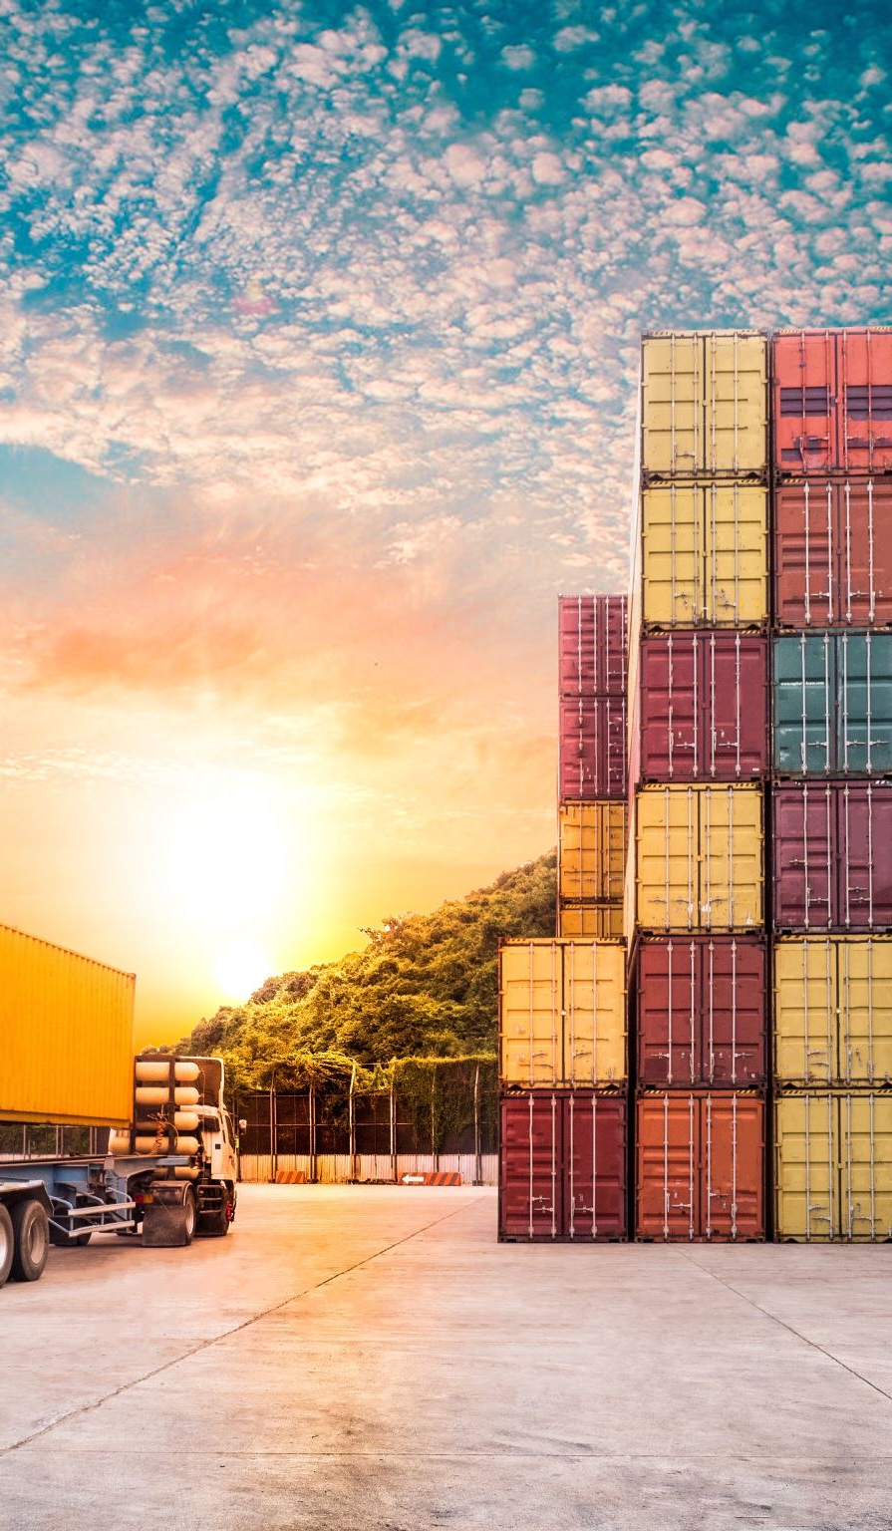
Ideal Economic, Social and Political Conditions for a Thriving Business Environment
Robust infrastructure
Recently upgraded Tema port
Excellent airport facilities for freight and cargo
New rail systems and rehabilitation of existing ones
Abundant and reliable electricity
Young and educated workforce
Ghana is Number 1 in West Africa in literacy and graduation rates
Availability of skilled and trainable labour
Stable and peaceful democracy
Number 1 in West Africa and 2nd in Africa in 2021 Global peace index

Slide 13
Incentives available to investors in Ghana
  Free zone
  incentives
  Tax and duty exemptions
  Expatriate work permits
  Dividend repatriation
  100% exemption from import and export duties
  10 years’ exemption from corporate income taxes
  Exemptions from customs duties on agricultural machinery and inputs
  Automatic work permits for expatriates with foreign equity investments
  No questions-asked transfer of dividends, fees for royalties, loan servicing, etc.
  Liberalized foreign exchange regime

Slide 14
Investment incentives to support foreign and local investors
SECTOR/ACTIVITY | CONCESSIONARY TAX RATE
Tree crop farming and cattle farming, | 1% for 10 years from start of operation
Cash crops/farming livestock, other than cattle or fish, Agro-processing business – converting fish, livestock into edible canned products, income from a cocoa by-product business | 1% for 5 years from start of operation
Income of a company from a waste processing business | 1% for 7 years from start of operation

Slide 15
Investment incentives to support foreign and local investors
LOCATIONAL INCENTIVES FOR AGRO-PROCESSING COMPANIES OUTSIDE FREEZONES After the five-year concessionary period, agro-processing enterprises using agricultural raw materials as their main inputs have corporate tax rates fixed according to their location for another five years (5yrs) | CONCESSIONARY TAX RATE
Accra/Tema | 20%
Other Regional Capitals (outside the Northern Savannah Ecological Zone) | 15%
Outside other Regional Capitals (Districts) | 10%
The Northern Savannah Ecological Zone (5 Regions) | 5%
FREE ZONES INCENTIVES FOR AGRO-PROCESSING COMPANIES- 1. Exemption from the payment of income tax on profits for the first 10 years | CONCESSIONARY TAX RATE
2. Income tax after ten years shall not exceed a maximum of 8%
3. A foreign investor may take and hold a maximum of 100% of the shares. (The Free Zone Act, 1995, Act 504)

Slide 16

Conclusion
Ghana is not interested in aid but partnership for investment that will lead to job creation and poverty alleviation, i.e. investment for mutual benefit.

Slide 17
THANK YOU

Slide 18
QUESTIONS AND ANSWERS

