Slide 1
Social Narratives, Economic Realities and the Outlook for 2024 Focus on California
Christopher Thornberg, PhD
Founding Partner, Beacon Economics
May 2024

Slide 2
Overview
Beacon Economics
Founded in 2006 on the basic principle of letting the data drive the narrative
Custom economic reports, analyses & forecasts
Today’s Presentation
What we think is happening in our economy
What is actually happening in our economy
How the combination of the two drive the outlook
Access to slides available through QR code at end of presentation
Social Narrative
Social Narrative
Economic Reality

Slide 3
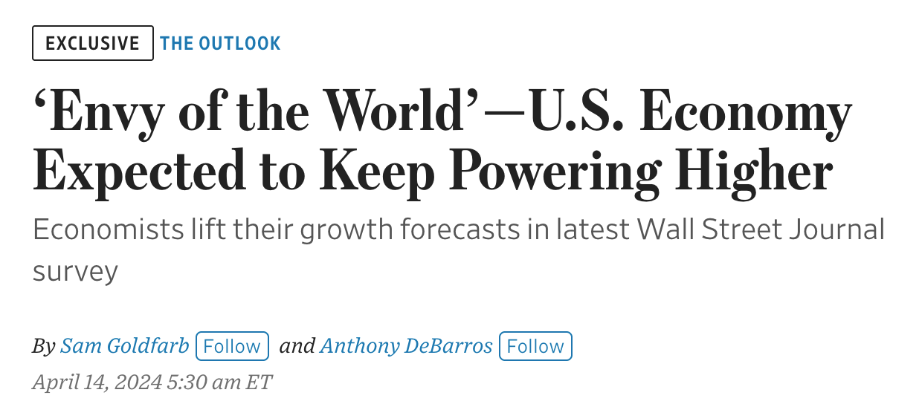
The 2023 / 2024 Macro Narrative

Slide 4
Beacon’s Outlook

Slide 5
Beacon’s Outlook for ’24
There was little risk of a “hard landing”
Presumed distress were signs of an overheated economy
The Good: economy will continue to expand at a decent pace
The Bad: interest rates will not be falling soon
The Ugly: Asset markets, federal deficits, and labor supply
California Economy: Not Dead Yet
Economy is stronger than the headlines would have you think
Housing shortages remain dominant issue
Budget deficit a function of poor fiscal planning
The Big Issue: false narratives / bad policies
Political partisanship / inability to compromise
“Crisis management” mode preventing pursuit of good policies
Big story of 2024: one very ugly election

Slide 6
2023: A solid year for growth
Contributions to Real GDP Growth
 | 2019 | 2022 | 2023
Gross domestic product | 2.50 | 1.90 | 2.50
Final Demand | 2.54 | 1.76 | 2.23
Personal consumption | 1.35 | 1.72 | 1.49
Durable goods | 0.23 | -0.02 | 0.34
Nondurable goods | 0.40 | 0.09 | 0.13
Services | 0.71 | 1.65 | 1.02
Fixed investment | 0.48 | 0.24 | 0.09
Structures | 0.08 | -0.06 | 0.36
Equipment | 0.06 | 0.26 | -0.01
IPP | 0.37 | 0.48 | 0.23
Residential | -0.04 | -0.44 | -0.49
Net exports | -0.12 | -0.48 | 0.58
Exports | 0.06 | 0.76 | 0.32
Imports | -0.18 | -1.24 | 0.26
Government | 0.68 | -0.16 | 0.68

Slide 7
Q1: Slower output, not demand
Contributions to Real Growth | 2024 | 2023
 | Q1 | Avg
GDP | 1.60 | 3.15 | -1.55
Final Demand | 2.81 | 3.29 | -0.48
Consumer Services | 1.78 | 1.10 | 0.68
Residential | 0.52 | 0.02 | 0.51
Inv Equipment | 0.10 | -0.03 | 0.13
Inv IPP | 0.29 | 0.17 | 0.12
Change inventories | -0.35 | -0.36 | 0.01
Exports | 0.10 | 0.20 | -0.10
Consumer Nondurables | 0.00 | 0.30 | -0.30
Consumer Durables | -0.09 | 0.46 | -0.55
Government | 0.21 | 0.79 | -0.58
Imports | -0.96 | 0.02 | -0.98

Slide 8
Americans having fun!!
38% higher than pre-pandemic

Slide 9
The New Roaring 20’s?
Total 4 Year Growth: 20%
6% Growth 2022-23
-1% Growth 2022-23

Slide 10
Little visible financial distress

Slide 11
US Labor Markets still tight

Slide 12
Rates up, but investment steady
Real Fixed Investment | Ch From Q4 19 | Ch From Q4 23
Private fixed investment | 7.4% | 3.6%
Manufacturing Str. | 99.2% | 73.9%
Software | 52.8% | 7.8%
Research Development | 15.7% | -0.1%
Information equip | 14.3% | -0.9%
IPP | 1.9% | -0.5%
Industrial equipment | 0.9% | -1.7%
Residential Str. | -3.5% | 0.4%
Commercial health care Str. | -9.4% | 5.2%
Transportation equipment | -11.6% | 2.8%
Mining, shafts, wells | -12.8% | -11.6%

Slide 13
Frozen Housing Market, and yet…

Slide 14
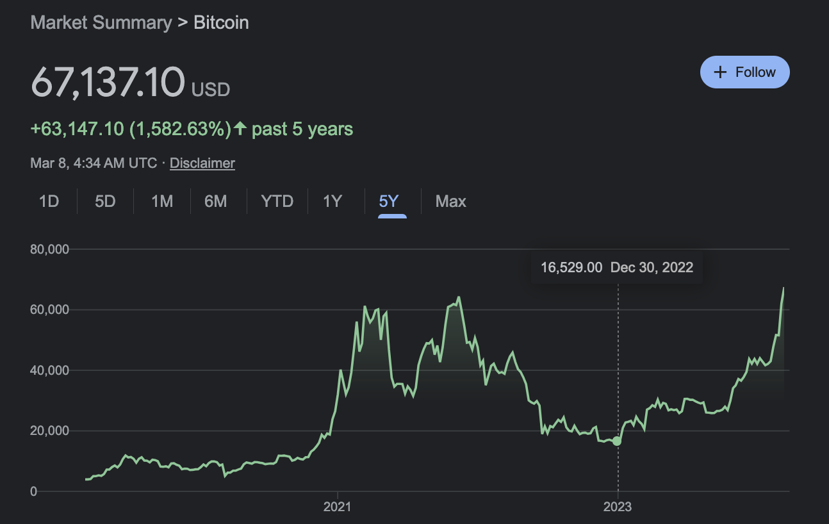
Slowing Inflation / Rising Confidence

Slide 15
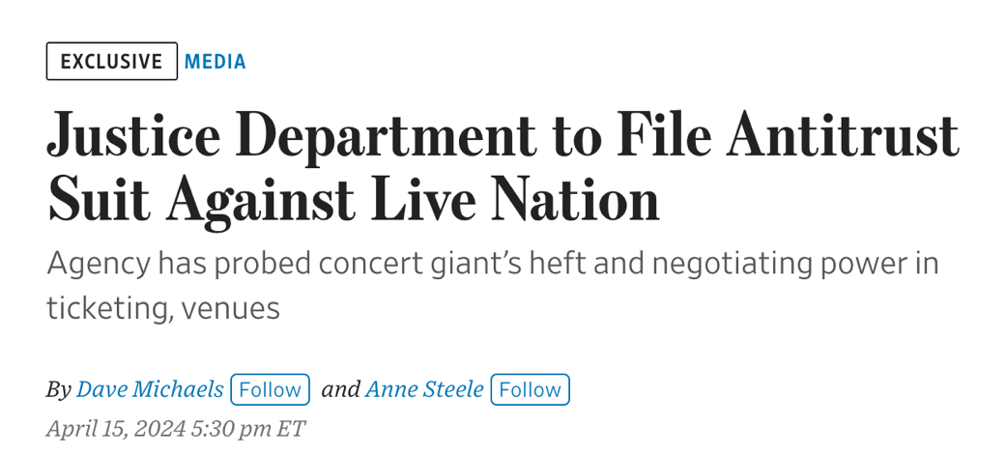
Beware the Narrative
Social Narratives
Economic Reality
“We need to incorporate the contagion of narratives into economic theory. Otherwise, we remain blind to a very real … mechanism for economic change..”
―R. Shiller, Narrative Economics
Ticketmaster fees are too high
The Unsustainable Federal Deficit
The Value of Bitcoin

Slide 16
Miserabilism and the Pandemic

Slide 17
The Pandemic Over-reaction
Actual Lost GDP: $1.2 Trillion
Fiscal Stimulus: $6 Trillion
$50,000 in stimulus / household

Slide 18
Fed Reserve: The “Enabler”
Powell QE $5T 20-21
Bernanke QE $3.5T 08-14

Slide 19
Wealth & Money = Demand & Inflation
Real Median Net Worth for US Households in 2022 ($thousands) and Growth Rate 2013-2022
Percentile of net worth |  |  |  | Percentile of income
All families | $193 | 87% |  | Less 20 | 17 | 119%
Less 25 | $4 | n.a. |  | 20–39.9 | 55 | 94%
25–49.9 | $93 | 134% |  | 40–59.9 | 171 | 118%
50–74.9 | $356 | 67% |  | 60–79.9 | 299 | 48%
75–89.9 | $1036 | 61% |  | 80–89.9 | 793 | 107%
90–100 | $3795 | 59% |  | 90–100 | 2651 | 84%

Slide 20
Consumer Spending Boom
 | 5 Year | 1 year
Total | 14.0% | 2.4%
Recreational goods vehicles | 85.4% | 8.3%
Furnishings / HH equipment | 26.7% | 2.8%
Clothing and footwear | 23.6% | 1.8%
Health care | 15.1% | 4.6%
Food services / Hotels | 13.9% | 2.6%
Food Retail | 10.7% | 1.2%
Motor vehicles and parts | 9.7% | -5.3%
Housing and utilities | 7.6% | 1.3%
Transportation services | 6.2% | 3.3%
Recreation services | 5.4% | 2.2%
Financial services | 1.2% | 3.2%
Gasoline energy goods | -3.4% | 0.0%
Los Angeles Coastal Waterway August 2021

Slide 21
Outlook for Consumers: Still Good

Slide 22
The Longer Run Context

Slide 23
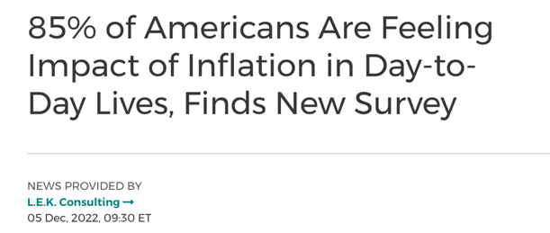
The narrative on inflation

Slide 24
Reality: Inflation is caused by demand
+50%
-1.5%

Slide 25
Why oil prices don’t matter anymore

Slide 26
Long Run Issue: Labor Supply, not Consumer Demand

Slide 27
The Era of Labor Shortages is Here

Slide 28
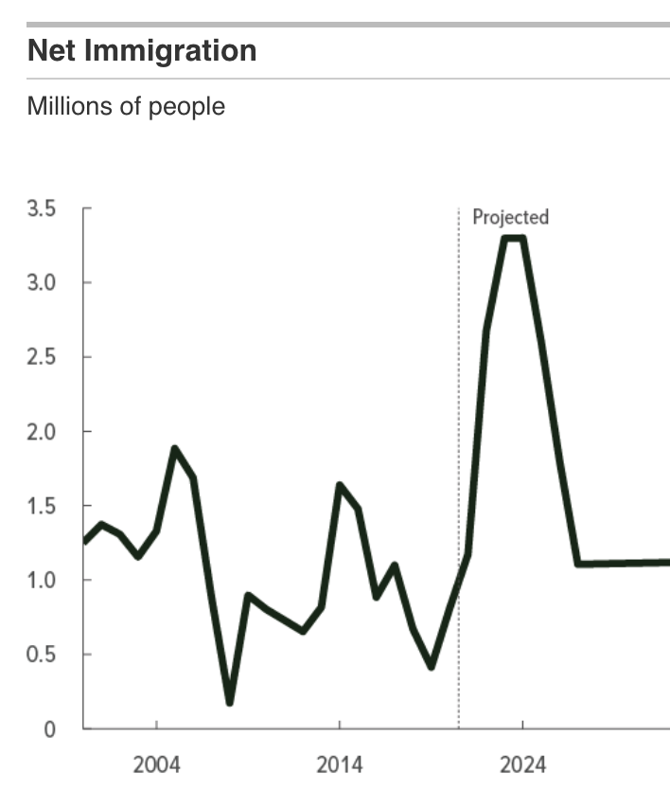
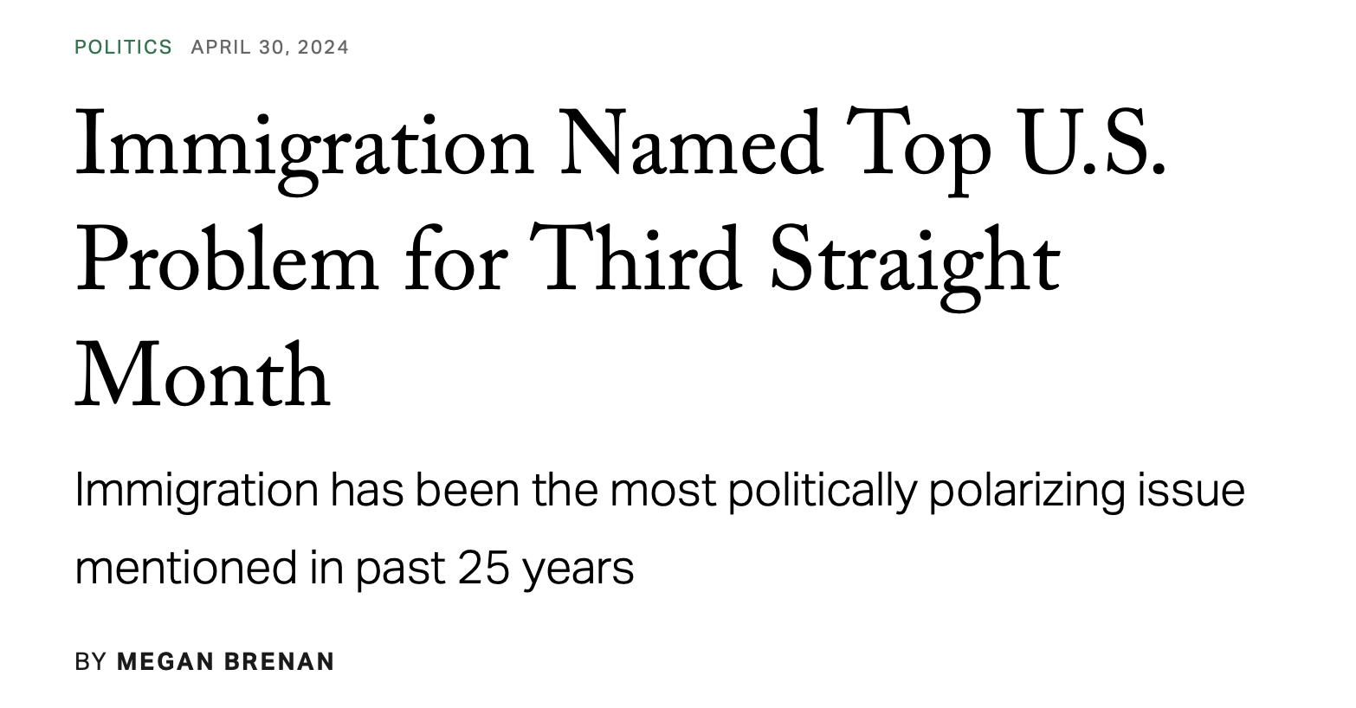
Labor Supply Issues

Slide 29
Wage Impacts
Weekly Earnings for
Non-Supervisory Employees
 | Feb 2024 | 2016-2020 | 2020-2024
Childcare services | $574 | 15% | 31%
Accommodation | $605 | 13% | 29%
Pet care | $508 | 6% | 28%
Personal care serv | $576 | 12% | 28%
Nursing residential care fac | $730 | 18% | 27%
Food services | $430 | 20% | 25%
Repair and maintenance | $991 | 16% | 24%
Warehousing and storage | $884 | 9% | 21%
Retail trade | $616 | 16% | 21%
Truck transportation | $1,158 | 13% | 18%

Slide 30
United States and Mexico
U.S. 10% tariffs on Chinese exports announced

Slide 31
Mexico Foreign Direct Investment

Slide 32
Whither the Golden State?
From the Right: California is a failing economy!
From the Left: California is failing its people!
From the Governor: We are the envy of the world!!

Slide 33
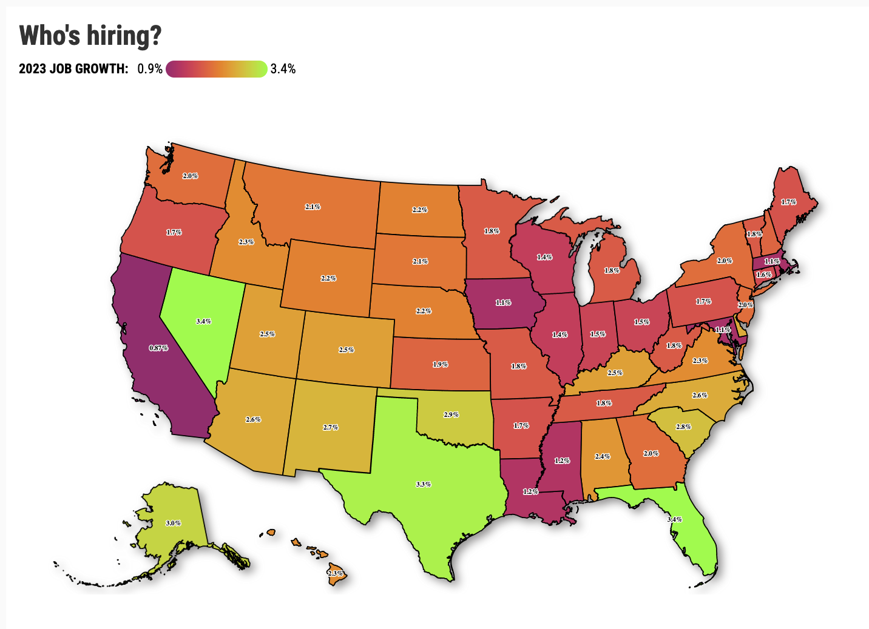
State Labor Markets
 | 24-Jan | 20-24
Civilian Labor Force | 19,357 | -1.10%
Total Nonfarm | 18,007 | 2.00%

Slide 34
California in Context

Slide 35
State Labor Supply & Housing
 | 02-12 | 12-22 | Rank
Utah | 14.3% | 29.3% | 1
Idaho | 12.6% | 23.1% | 2
Arizona | 13.8% | 18.4% | 3
Colorado | 12.3% | 16.4% | 4
Texas | 17.7% | 16.0% | 5
Florida | 16.0% | 15.3% | 6
Washington | 11.9% | 15.0% | 7
Nevada | 20.5% | 13.4% | 8
Nebraska | 6.3% | 4.6% | 24
Minnesota | 2.7% | 4.3% | 25
California | 7.2% | 4.1% | 26
Hawaii | 8.1% | 4.0% | 27
New Jersey | 5.3% | 3.6% | 28
Vermont | 3.1% | -3.3% | 48
Maine | 3.3% | -3.7% | 49
Wyoming | 12.7% | -3.9% | 50
Mississippi | 3.1% | -6.0% | 51

Slide 36
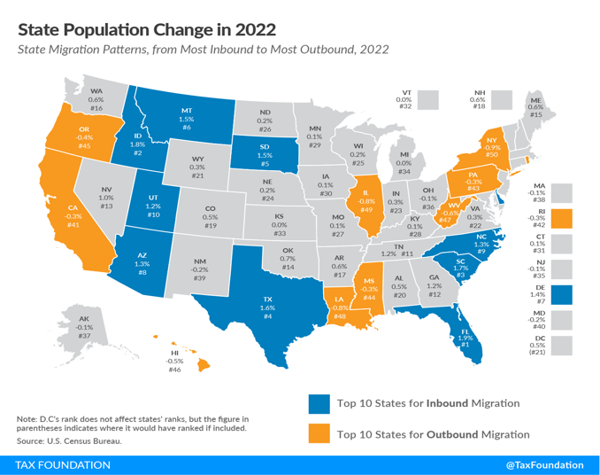
California’s Population Decline
County | 2023 Population | 1-Year Change (%) | 10-Year Change (%)
California | 38,940,231 | -0.4 | 1.8
Los Angeles | 9,761,210 | -0.7 | -2.6
San Diego | 3,269,755 | -0.2 | 2.2
Orange | 3,137,164 | -0.5 | 1.1
Riverside | 2,439,234 | 0.3 | 7.5
San Bernardino | 2,182,056 | 0.1 | 4.7
Santa Clara | 1,886,079 | -0.3 | 1.2
Alameda | 1,636,194 | -0.5 | 4.2
Sacramento | 1,572,453 | -0.1 | 8.1
Contra Costa | 1,147,653 | -0.4 | 5.7
Fresno | 1,011,499 | 0.2 | 5.7
Kern | 907,476 | -0.1 | 5.0
San Francisco | 831,703 | -0.6 | -1.5
Ventura | 825,653 | -0.7 | -1.8
San Joaquin | 786,145 | 0.4 | 11.6
San Mateo | 737,644 | -0.4 | -1.3

Slide 37
“Fleeing”?

Slide 38
Spreading Out
 | Population |  | Households
 | 2023 |  | 2023
Los Angeles | 9,542,781 | -4.0% | 3,664,182 | 5.1%
Orange | 3,085,670 | -0.3% | 1,149,943 | 7.5%
Riverside | 2,399,217 | 5.1% | 872,930 | 6.1%
San Bern. | 2,144,993 | 3.5% | 747,011 | 5.3%
 | Vacancy Rate |  | People / HH
 | 2023 |  | 2023
Los Angeles | 5.2% | -0.9% | 2.75 | -9.5%
Orange | 5.1% | -0.3% | 2.83 | -7.5%
Riverside | 10.1% | -3.5% | 3.06 | -4.7%
San Bern. | 8.8% | -3.1% | 3.15 | -5.0%

Slide 39
A Gentrifying Population
California Educational Attainment | 2022 Labor Force | 10-Year Chg. %)
Less than HS | 1,959,233 | -17.2
HS Graduate | 3,155,868 | 6.1
Some College | 4,417,887 | -7.9
Bachelor's + | 6,849,482 | 26.2
California Population by Age | Population | 10-Year Change (%)
Under 25 | 12,162,569 | -8.3
25 to 44 | 11,139,847 | 4.6
45 to 64 | 9,568,024 | 0.4
65 and over | 6,158,902 | 33.9

Slide 40
Income and Earnings
Education | 2022 Earnings ($) | 1-Year Chg. (%) | Chg. Since 2019 (%)
Population 25 + | 52,520 | 5.0 | 16.0
Less than HS | 30,843 | 8.0 | 19.0
High School Diploma | 38,507 | 6.0 | 15.0
Some College | 47,535 | 10.0 | 16.0
Bachelor's Degree | 75,688 | 6.0 | 16.0
Grad/Prof Degree | 103,600 | 4.0 | 12.0

Slide 41
Not Affordability

Slide 42
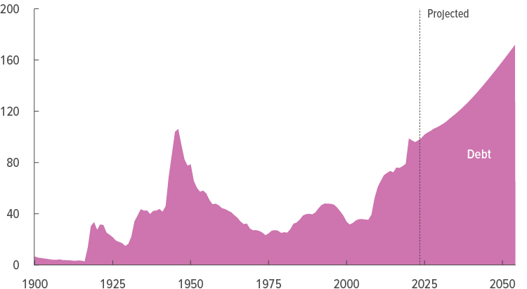
Powell’s Legacy: The Federal Deficit

Slide 43
Powell’s Legacy: Frothy Asset Prices

Slide 44
Out of the Woods?
We were never in the woods.
Excess demand causes inflation, not recessions
Higher rates offset by high liquidity, low private debt levels
Consumer demand will remain strong keep US going
The California Situation
Housing Supply not affordability
Revenue reform not higher taxes
Upskill workers, not up pay
Don’t fix—get out of thew way
Medium Term Risks
Record federal deficits with no end in sight
Asset prices remain at bubbly high levels
The real issue?
The narrative is running amuck
Political chaos in its wake
2024 Beacon
Forecast Highlights
GDP Growth: 1.8%
Consumer shift to services
Unemployment Rate: 3.9%
10 Year Treasury: 4.2%
30 Year FR Mortgage: 7.6%
HPI Forecast: -1.7%
Housing Starts: 1.42m

Slide 45
Sticky Narratives
“People can believe pretty much whatever they want to believe about moral and political issues, as long as some other people near them believe it, so you have to focus on indirect methods to change what people want to believe.
― Jonathan Haidt, The Righteous Mind: Why Good People are Divided by Politics and Religion

Slide 46
Thank You!
For a copy of slides, please use the QR Code
Or contact:
Kristen@beaconecon.com

