Slide 1
The California Consumer Privacy Act: Employee and Business to Business Exemptions

Slide 2
Presenter Contact Information
Ashley Hoffman
Policy Advocate, CalChamber
Ashley.Hoffman@calchamber.com
Ronak Daylami
Senior Counsel, Nielsen Merksamer
rdaylami@nmgovlaw.com

Slide 3
Before the CPRA…there was the CCPA
2018: California enacts California Consumer Privacy Act (CCPA) (Chau, Hertzberg)
Stakeholders negotiated for privacy legislation that was contingent on the revocation of a then-pending ballot initiative sponsored by Californians for Consumer Privacy
The first comprehensive consumer privacy statute in the United States
Became effective on January 1, 2020
Notes:
It was a negotiated process to provide a legislative alternative to Alastair MacTaggert’s ballot initiative on the same subject matter, in part arising out of frustration that legislative efforts weren’t getting anywhere.
Negotiated in complete confidence with stakeholders
At end of the day, this provided legislators (and stakeholders) with an option to make, or as Hertzberg would call it, Door #1 and Door #2:
Door #1: the 2018 ballot initiative Door #2 AB 375, the CCPA. Door #2 included tradeoffs made by both industry and consumer privacy groups. Door #2 was also closer to GDPR conceptually: right to specific pieces of information, minors receive special protection, right of deletion, data portability.
In terms of the tradeoffs, this isn’t comprehensive but notably, some of those negotiated elements got undone by Prop 24 just months after the CCPA took effect: Whistleblower provision were deleted, and the private right of action was limited to the data breach section. Right to cure when possible was added to both the public and private enforcement provisions; Public enforcement was limited to the AG and the AG was specifically authorized to give guidance to businesses effectively to aid compliance, new exemption were added compared to the original initiative and we added specific authorization for financial incentives such as loyalty programs, the sell definition was dramatically narrowed to exclude situations that did not involve valuable consideration, and the consumer disclosures around third parties was changed from listing specific third parties to naming categories of third parties.
Before delving into the components of the act, want to stress that this wasn’t a bill about certain social media companies. It is about all industries, all businesses, brick and mortar as well as online, businesses –everyone who meets certain thresholds in the bill. The definitions of some of the related terms are atypically broad and can trip people up:
Collection means buying, renting, gathering, obtaining, receiving or ACCESSING any PI pertaining to any consumer, BY ANY MEANS, including receiving PI from the consumer ACTIVELY OR PASSIVELY or by observing the consumer’s behavior.
Sale was defined to mean not just selling but renting, releasing, disclosing, disseminating, making available transferring or otherwise communicating BY ANY MEANS (orally, in writing, electronically, or otherwise) a consumer’s PI to another business or third party for ANYTHING OF VALUE (not just monetary consideration) in return.
PI means information that identifies, relates to, describes, is reasonably capable of being associated with, or could reasonably be linked, DIRECTLY OR INDERECTLY, with a particular consumer or HOUSEHOLD. The only exclusions here are deidentified data, aggregated data or publicly available information.
Business was defined to effectively mean ANY legal entity short of a nonprofit or government entity, that (1) collects PI or on behalf of which that information is collected and (2) that alone OR jointly with others determines the purposes and means of the processing of consumer PI and (3) that satisfies one of three thresholds: (a) has gross revenue in excess of 25M, (b) alone or in combination annually buys, (3) receives for commercial purposes, sells or shares for commercial purposes, alone or in combination, the PI of 50,000 consumers, households or devices, or derives 50 % or more of its annual revenue from selling consumer PI.

Slide 4
What does the CCPA do?
Applies to for-profit businesses that collects consumer data above certain thresholds
Creates six core privacy rights for consumers:
Right to Know
Right to Access
Right to Delete
Right to Opt-Out (or opt-in for minors under 16)
Right Against Discrimination/Retaliation
Right to Sue for Data Breach
Notes:
first two items are related, but still distinct:
There is a right to know information about a businesses’ collection, sale/disclosures of PI—effectively, the right to know about the categories of personal information that a business collects about a consumer, but the purposes for its use, at or before the point of collection. You can find such disclosures in the business’s privacy policy. Relatedly….
You have the right to request access to your specific pieces of PI, though also recognizing that it is important that businesses only have to do this in connection with a verifiable request since divulging my PI to my roommate or my parent would be a violation of my privacy rights [see 1798.100, .110, .115] The consumer can access and obtain a copy of their PI that was collected in the prior 12 months, free of charge, but no more than 2x a year.
Right to delete PI collected FROM the consumer. The FROM is critical. I cannot delete a photo that Ashley has posted of both of us. First amendment rights come into play here, as do other issues around fraud prevention and so forth. That is why this section has its own specific exemptions, in addition to the general ones that apply more wholistically to the act. (.105)
Right to opt out of the sale of your PI if you are 16 years of age or older and the right to opt-IN if you’re under 16. if under 13, then the right to opt in is to be exercised by a parent/guardian.
The right of discrimination (or retaliation) was an issue that goes to the concept of “pay for privacy”. If we were going to allow for you to exercise your rights to opt out, but also allow for financial incentives that allow you to get your music free on spotify, then we wanted to make sure that we don’t end up with the situation where the only people who can afford to exercise their right of privacy are persons with sufficient wealth to pay for the premium versions of things. By that same token, if I opt out- I shouldn’t get a lesser service than the person who doesn’t.
Lastly, the right to sue for data breaches. Pretty self-explanatory, but it is a good reminder for companies to make sure to redact and or encrypt their information.
There is also another right that often doesn’t come up, but that was specifically negotiated into the bill by some, and that is the right to data portability if delivered in electronic form.

Slide 5
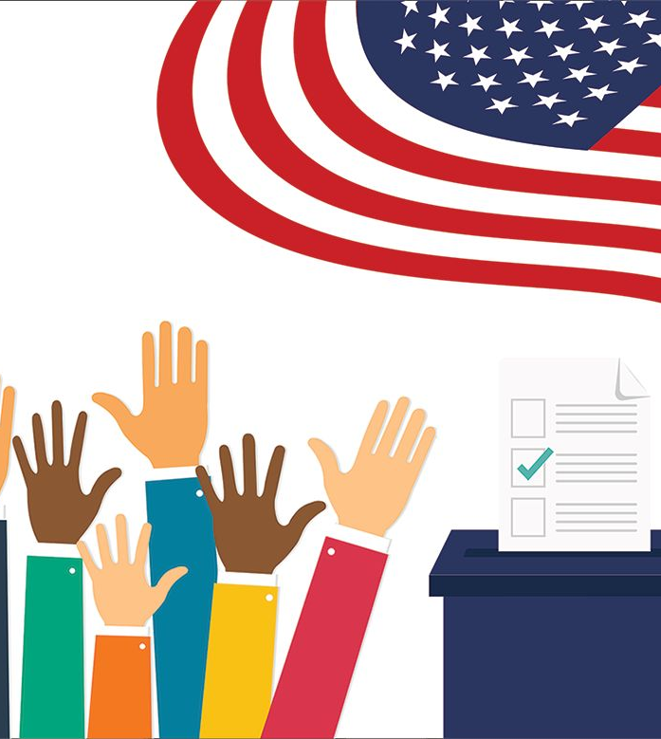
Prop 24: Consumer Privacy Rights Act
Ballot measure on November 2020 ballot
Approved by 56% of the voters
Makes changes, clarifications to CCPA
Notes:
While part of the negotiation process in the CCPA required Alastair MacTaggart to drop his original initiative, just two years later we all ended up voting on another initiative, and that is Prop 24 and now, our Consumer Privacy Rights Act, the bulk of which doesn’t take effect until January 1, 2023.

Slide 6
Key Changes from CCPA to CPRA
Adds Right to Correct
Expands Right to Delete
Expands Right to Know
Expands Right to Opt-Out
Creates California Privacy Protection Agency
Removes Business’s Right to Cure
Adds “data minimization” requirements
Limits retention
Notes:
Number of changes were made by Prop 24. As previously mentioned, some of those were key to the successful deal that was struck.
New disclosures and notices are now mandated at or before the point of collection; a person may now opt out of “sharing”,
special rights were added around “sensitive” PI (can stop and/or minimize use),
Deleted the administrative right to cure and the ability to seek guidance,
modified obligations relating to service providers and third parties, and specifically expands the right to delete to also require the business to notify service providers, contractors and third parties to delete the consumer’s PI from their records with limited exception.
added a new right of correction, expanded the right of access so it’s no longer limited to the prior 12 months starting jan. 1, 2022,
begins to address profiling and auto-decision making based on profiles,
adds the concept of cross-context behavioral advertising,
narrows the scope of PI to exclude that which is publicly available information;
expressly recognizes loyal programs and prohibits retaliation against employees, applicants or independent contractors,
added enforcement capabilities and created the new CPPA, and
added an annual cybersecurity audit requirement for high-risk businesses.
Altered the scope of businesses subject to the act, including by way of expanding the definition of business to capture joint ventures and to allow for companies to voluntarily submit to being bound by the CPRA
The new law also inserted some key new principles, one being the concept of data minimization (where you only collect the minimum amount of PI necessary and proportionate to achieve the purposes for which the PI was collected or processed and not further process the data in an manner that is incompatible with those purposes). The other relates to data retention, and prohibits retaining PI for longer than is reasonably necessary for their disclosed purposes.
CCPA already broadly defined sell to include instances of sharing, or disclosing, where there is valuable consideration or monetary value. Think: trading lists. Now under CPRA sharing is specifically defined sharing to mean sharing, renting, releasing, disclosing by a business to a third party for cross-context behavioral advertising (i.e. targeted advertising to a consumer based on their PI obtained from the consumer’s activity across businesses, applications, services, other than those with which the consumer has intentionally interacts – deliberate interaction such as visiting the website or purchasing a good/service vs. hovering over, muting, closing a piece of content, etc.) regardless of whether there was valuable consideration or monetary value involved

Slide 7
Does the CCPA/CPRA Apply to Employee Data?

Slide 8
Existing Employee Rights
Right to access:
payroll records
personnel records
any document signed by employee
Protection against retaliation:
for correcting or changing name, SSN, federal employment documents
for opposing unlawful practices
Right against certain disclosure of conviction history, prior salary information

Slide 9
Broad Definition of Personal Information
“Personal information” means information that identifies, relates to, describes, is reasonably capable of being associated with, or could reasonably be linked, directly or indirectly, with a particular consumer or household . . . .

Slide 10
Employee and Business to Business Exemptions
During negotiations of CCPA, questions were raised as to whether CCPA should apply to employee and job applicant data
Amendments added in an exemption for employee data and data collected during business to business transactions
Exemption sunset was originally January 1, 2022, changed to January 1, 2023 by CPRA

Slide 11
How would CPRA apply to employees?
Due to the breadth of the “personal information” definition, the CPRA would apply to: employee emails, personal effects in an employee’s office, personal documents on work computer, work phone usage, work product, etc.
Employees would have an unfettered right to delete documents, emails, or other files
Employees would also have the right to change files under the “right to correct”
Requests for personal information would result in thousands of records

Slide 12
Examples of Unintended Consequences
Right to delete:
An employee engaging in inappropriate or illegal behavior would have the right to have all of that evidence deleted.
Right to Opt Out:
An employee could limit sharing of their contact information with labor organizers
Right to Correct:
An employee would have the right to “correct” HR investigations or disciplinary notices
Right to Access:
A request to access records would generate thousands of documents, including obligating the employer to go into an employee’s physical office to collect files or access any personal information stored on the employee’s work computer
Creates conflicts with existing laws, for example civil discovery rules

Slide 13
Other States Exempt Employee Data
Colorado
§ 6-1-1303(6) defines “consumer” as “an individual who is a Colorado resident acting only in an individual or household context; and . . . Does not include an individual acting in a commercial or employment context, as a job applicant, or as a beneficiary of someone acting in an employment context.”
§ 6-1-1304(2) clarifies that the law does not apply to “data maintained for employment records purposes”
Virginia
§ 59.1-571 defines “consumer” as a “natural person who is a resident of the Commonwealth acting only in an individual or household context. [Consumer] does not include a natural person acting in a commercial or employment context.”
§ 59.1-572(C) exempts “Data processed or maintained (i) in the course of an individual applying to, employed by, or acting as an agent or independent contractor of a controller, processor, or third party, to the extent that the data is collected and used within the context of that role; (ii) as the emergency contact information of an individual under this chapter used for emergency contact purposes; or (iii) that is necessary to retain to administer benefits for another individual relating to the individual under clause (i) and used for the purposes of administering those benefits.”
Other states also include: New York, North Carolina

Slide 14
Questions?

Slide 15
Thank You!

