Slide 1
The People’s Voice
Second Annual CalChamber Survey
of California Voter Attitudes

Slide 2
Methodology
Penn Schoen Berland (PSB) conducted online interviews from November 15 – November 17, 2016 among n=1,000 definite 2018 California general election voters.
The margin of error for this study is +/- 3.09% at the 95% confidence level and larger for subgroups. Some percentages may add to more or less than 100% due to rounding.

Slide 3
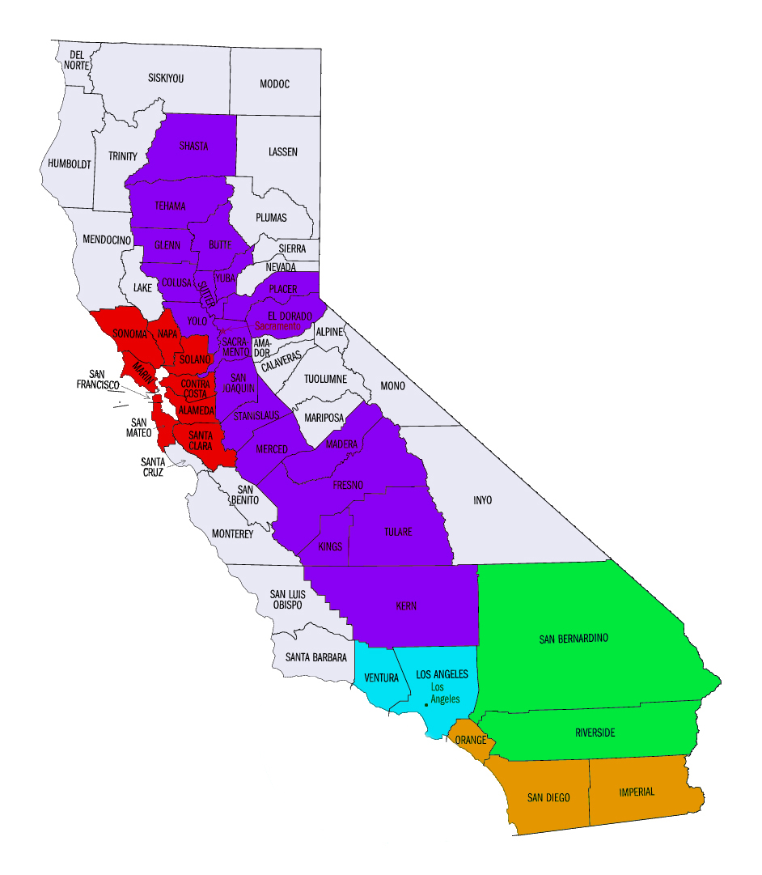
For analytical purposes, five regions encompassing ~95% of all voters
Central Valley (17%)
San Francisco Bay Area (20%)
Inland Empire (10%)
Los Angeles (30%)
Orange County / San Diego (17%)

Slide 4
Direction & priorities
The People’s Voice 2016

Slide 5
Two-thirds say USA is headed down the wrong path, majority say CA headed in the right direction
Would you say the United States is headed in the right direction, or would you say that things are headed down the wrong track?
67% wrong track (USA)
33% right direction
Would you say California is headed in the right direction, or would you say that things are headed down the wrong track?
46% wrong track
54% right direction (CA)
2015 People’s Voice: 59% wrong track (US); 50% wrong track (CA)

Slide 6
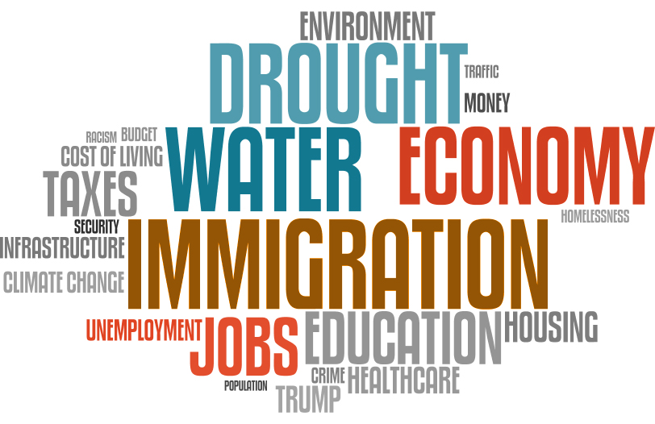
Biggest challenges in CA? Economy/jobs (16%), water/drought (15%), immigration (12%)
In your opinion, what would you say is the most important issue or challenge facing the state of California today? (OPEN END)

Slide 7
“Forced choice” reveals what voters want most from their legislators in Sacramento
Please indicate whether you feel elected officials in Sacramento are spending too much time or not spending enough time on:
Fixing roads, highways, and bridges in California
Encouraging economic development to attract new businesses to California
Addressing high housing costs
Dealing with the drought
Reforming government employee pensions
The need for the state to fight global warming
Providing tax credits to purchase electric cars
Completing high speed rail

Slide 8
Californians have largely come to accept that drought is a “new reality” (+4% point more than 2015)
3 in 4 (77%) say drought represents “a new reality for California”
Only 1 in 4 (23%) say drought represents “a short term problem”

Slide 9
Worries & concerns
The People’s Voice 2016

Slide 10
California voters give low marks to transportation infrastructure (unchanged since last year)…
How would you rate the repair and maintenance of California’s roads, highways, and bridges?

Slide 11
…and the preferred solution to addressing challenges is better management (not more money)
Which comes closer to your view?
Current funds need to be managed better
Need additional funds to address road maintenance issues
80%
20%

Slide 12
Here’s another “CalExit” to pay attention to
27% of those with children living at home strongly agree and 32% somewhat agree:
59%
My children will have a better future if they leave California
agree

Slide 13
Californians perceive the dream of homeownership as getting very tough for their children/younger people
AMONG THOSE WITH CHILDREN LIVING AT HOME: Do you think your children’s generation will have an easier or harder time purchasing their first home in California than your generation?
67% harder
33% easier

Slide 14
Throughout the state, Californians are strongly worried that middle class lifestyle is becoming almost impossible
Earning enough income to enjoy a middle class lifestyle is becoming almost impossible in my part of California.
Strongly agree
Somewhat agree

Slide 15
And while SF/Bay area enjoy new job creation, much of southern, CV and the IE view a different reality…
How would you describe the job creation climate in your part of California?

Slide 16
…with most new jobs as dead end/no path to Middle Class in OC/SD, Central Valley, and Inland Empire
AMONG THOSE WHO SAY “A LOT” OR “SOME NEW” JOBS BEING CREATED IN THEIR PART OF CA: Would you say most of the new jobs being created are the type that lead to higher pay and middle class living, or are most of the new jobs being created the type that tend to be dead ends that don’t lead to the middle class?

Slide 17
Specific issues
The People’s Voice 2016

Slide 18
Prop 13 is favorably viewed across age but also partisan lines
Do you have a very favorable, somewhat favorable, somewhat unfavorable, or very unfavorable view of Prop 13?
Very favorable
Somewhat favorable
Prop 13
Regardless of party reg., do you consider yourself…
DEM REP IND

Slide 19
By and far, voters want drought relief and prevention as the highest environmental priority in Sacramento
Of the following environmental concerns, which do you believe should be the highest priority for the California legislature?

Slide 20
Majority of California voters oppose new housing development requirements stemming from SB 32
California housing experts say that to reach the new greenhouse gas standards set by legislature in SB 32, new housing developments must become much more energy efficient, including producing their own clean electricity and reducing automobile use. They estimate the cost to accomplish these goals will raise the cost of new single family homes by $58,000 per unit. This increase will price even more people out of the California housing market, especially middle-class families.
Do you strongly support, somewhat support, somewhat oppose, or strongly oppose these new housing permit requirements?
SB 32
56% oppose
44% support
28% strongly oppose
10% strongly support
28% somewhat oppose
34% somewhat support

Slide 21
A look to the future
The People’s Voice 2016

Slide 22
Similar to the country as a whole*, California sharply divided the role of newcomers in American society
Which of the following comes closest to your view?
The growing number of newcomers from other countries…
…strengthens American society
…threatens traditional American customs and values
*PSB National Post-Election poll: 49% “threatens” vs. 51% “strengthens”

Slide 23
Neither Democrats nor Republicans have a lock on 2018 Governorship (only ~700 days ‘til the Election!)
Thinking about the 2018 race for Governor, do you think you would vote for a…?
Democratic candidate
Republican candidate
Don’t know

Slide 24
But don’t renounce your US citizenship or stop paying Federal taxes quite yet – only 1 in 3 (32%) back “CalExit”
California isn't like any other US state given its large and diverse population, the size and scope of its economy, and its unique prominence worldwide in terms of trade, agriculture, technology, entertainment, and culture. Given the recent Presidential election results, California should be its own nation, separate from the rest of the US.
68% disagree
32% agree

Slide 25
Robert Green, Principal
rgreen@ps-b.com
202-962-3049

