Slide 1
Trade Update and Outlook: A View from Washington
CalChamber International Forum May 31, 2017

Slide 2
Who Said It?

Slide 3
“We are absolutely going to keep trading. I am not an isolationist… I want free trade, but it’s got to be fair trade. It’s got to be good deals for the United States… The fact that I’m negotiating trade will mean that we’re going to make good trade deals.”
TRUMP 2016

Slide 4
NAFTA has been “devastating” and “a big mistake… We should use the hammer of a potential opt-out as leverage to ensure that we actually get labor and environmental standards that are enforced.”
OBAMA 2008

Slide 5
The Opportunity and the Challenge of Trade

Slide 6
The Opportunity of Trade
JOBS: 41 million American jobs depend on international trade
GROWTH: Exports rose by 50% in 2009-2014
Led by growth in exports to Mexico and Canada
MANUFACTURING: 1/2 of the 12 million U.S. manufacturing jobs depend on exports
AGRICULTURE: 1 in 3 acres on U.S. farms planted for export

Slide 7
Opportunity for California
Over $287 billion in exports
Mexico, Canada, China are top markets
Trade supports more than 4.8 million jobs
96% of exporters are SMEs
39% of exports went to FTA countries
Foreign firms employ 631,500 workers in California

Slide 8
The Challenge of Trade
U.S. market largely open to imports, but tariffs in developing countries much higher
It’s like going into a basketball game down by a dozen points from the tip-off
Discriminatory regulations and non-tariff barriers can make it even worse

Slide 9
The Solution? New, Market-Opening Trade Agreements

Slide 10
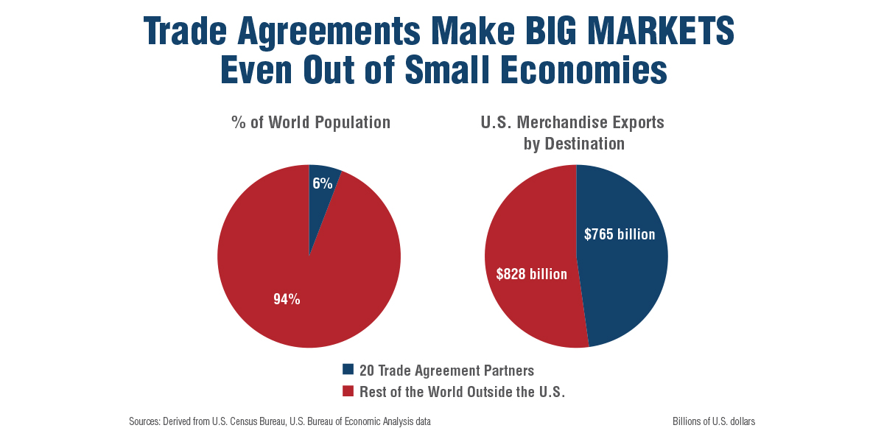

Slide 11
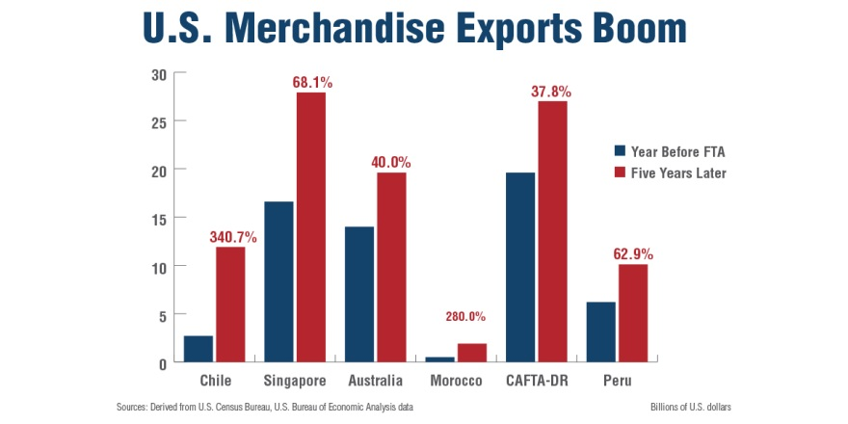

Slide 12
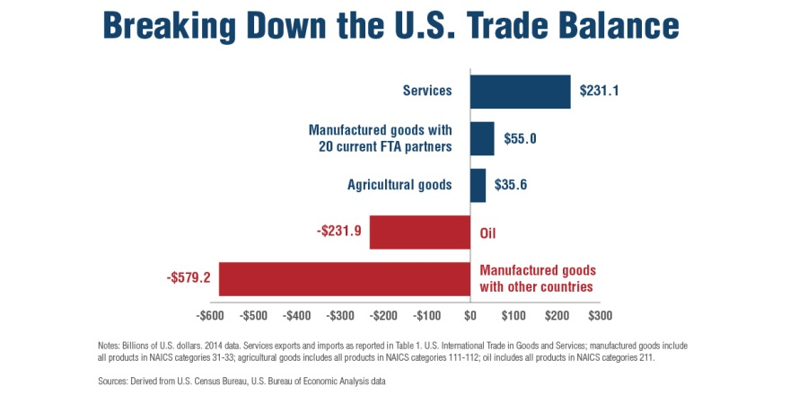

Slide 13
America Left Behind?
U.S. exports rose substantially in 2000-2014
But the U.S. share of global exports fell from 18% in 2000 to 8.5% in 2014
423 FTAs in force, but U.S. has FTAs with just 20 countries

Slide 14
Others Moving Ahead

Slide 15
Trump’s 7-Part Trade Plan
Withdraw from the Trans-Pacific Partnership
Appoint tough, smart trade negotiators
Crack down on violations of trade agreements
Renegotiate NAFTA or withdraw from it
Label China a currency manipulator
Challenge China subsidies, trade secret theft
Impose tariffs on imports if needed

Slide 16
Executive Actions
President Trump Executive Action on January 23, 2017:
I hereby direct you to withdraw the United States as a signatory to the Trans-Pacific Partnership (TPP), to permanently withdraw the United States from TPP negotiations, and to begin pursuing, wherever possible, bilateral trade negotiations to promote American industry, protect American workers and raise American wages.
Additional Executive Orders
FTA Review, OTMP, “Buy American, Hire American,” Steel/Aluminum imports, trade deficits, anti-dumping enforcement

Slide 17
“Renegotiate/Withdraw from NAFTA”
“[NAFTA is] a disaster...We will either renegotiate it, or we will break it. Because, you know, every agreement has an end”
Threat to impose a 35% tariff on imports from Mexico
Trump on April 27: “If I'm unable to make a fair deal for the United States, meaning a fair deal for our workers and our companies, I will terminate NAFTA. But we're going to give renegotiation a good, strong shot.”

Slide 18
The Facts on NAFTA
JOBS: 14 million American jobs depend on trade with Canada and Mexico
333,472 in MA
EXPORTS: $3.5 billion every single day and $1.2 trillion a year
MANUFACTURING: For manufactured goods, the U.S. ran a cumulative trade surplus with Canada and Mexico of more than $70 billion over the past eight years (2008-1015).
AGRICULTURE: Increase by 350%

Slide 19
NAFTA Recommendations
First, Do No Harm
Move quickly
Keep it Trilateral
Use the Amendment Process
Consult with Congress (TPA)
Notification letter sent to Congress on May 18

Slide 20
Multilateral vs. Bilateral
Trump Administration skepticism of multilateral approaches to trade
Future of negotiations at the WTO:
Old Issues-DDA, EGA, TiSA
-New Issues-Digital Trade/E-commerce
-December Ministerial
Bilaterals the way forward?
-Japan, Vietnam, Malaysia, U.K.
Warming up to TTIP?
-Dynamic of TPP 11

Slide 21
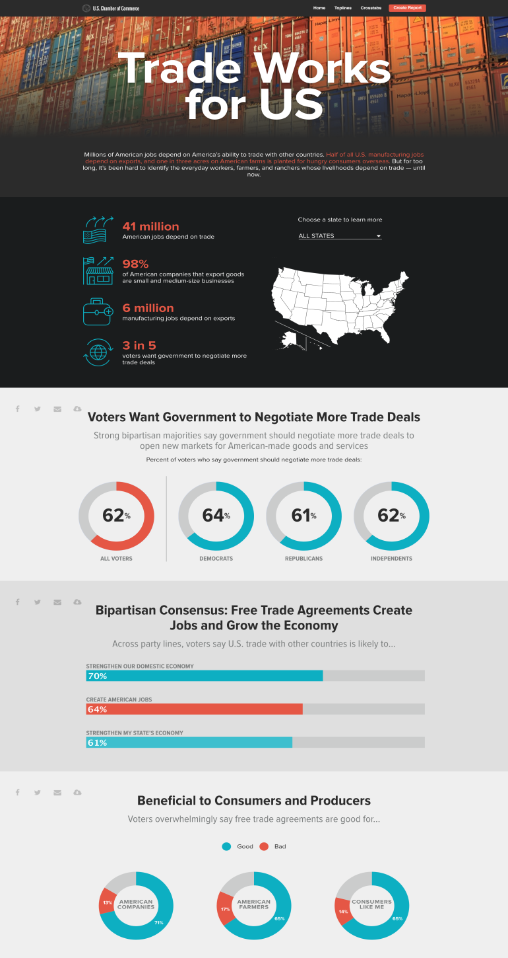
TRADEWORKSFORUS.COM

Slide 22
Final Thoughts
A new dealmaker in chief
“Where you stand is where you sit”
Role of Congress on Trade (TPA)
All eyes on NAFTA
Need to be vocal/Faces of Trade
Q+A

Slide 23
Christopher Wenk
Executive Director
International Policy
U.S. Chamber of Commerce
cwenk@uschamber.com
@ChristopherWenk

